Slide 1




VOIS Innovation
Marathon 2.0

Slide 2



Project Title
e-Voting 2.0 : Blockchain based Voting System
Insert your professional photo
Team No. 12
Tanushri Khatri, Computer Engineering
MKSSS’s Cummins College of Engineering for Women Pune, Maharashtra
Priya Pawar, Computer Engineering
Anushkaa Pawar, Computer Engineering

Slide 3
Problem Statement
BlockChain Based E-Voting System
India’s Voting System demands faster, secure and end-to-end verifiable mechanisms that ensures transparency, and scalable public trust in order to overcome challenges such as VVPAT counting delays, fake voting, lack of auditability, logistic complexity and lack of remote access, high dependency on human handling/manual process.

Slide 4
Need of Project
Duplicate and fake voting: To minimize multiple registrations and unauthorized voting, ensuring “one person, one vote.” Resources link1 | Resource link2
High dependency on manual processes: To reduce heavy manpower, paperwork, and human errors through automation. Resource link
Voting result delays: To speed up secure counting and result declaration with verifiable digital records. Resource link
Public trust issues: To give voters confidence that their vote is recorded correctly and cannot be tampered with.
Lack of remote access: To enable secure participation for citizens who cannot reach polling booths (migrants, elderly, disabled).

Slide 5
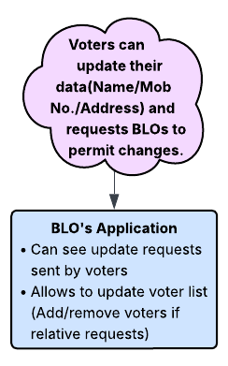
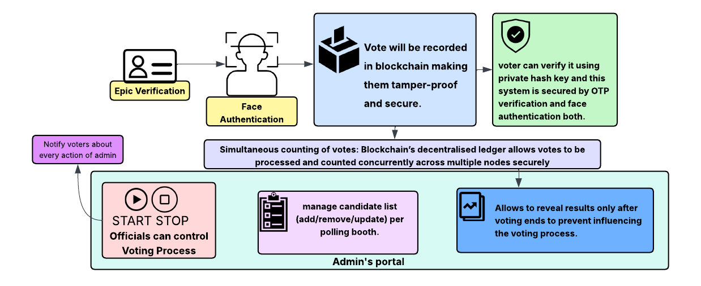
Proposed Solution
Our proposed solution is Blockchain-based Secure Digital Voting System to conduct elections in a transparent and tamper-proof manner.
The system ensures secure voter authentication using EPIC ID and face recognition.
Blockchain technology provides immutability, transparency, and trust in vote storage and counting.
The solution eliminates multiple voting and vote manipulation by locking voters after successful vote casting.
Our solution enables real-time vote counting and faster result declaration.
Also provides user-friendly system for Voters and BLOs.

Slide 6
Solution Overview
Blockchain based voting System includes 4 different interfaces for Election Commission’s Admins, Live Voting, Voter Verification Portal and for BLOs.
1) Admins officials manage candidate-list, control elections (start/end voting), and publish results after voting ended.
2) Voters can cast vote by verifying EPIC ID and after that face authentication on Voting Portal
3) Voters can verify their casted vote by first face verification and after that unique hash key verification.
4) BLO’s interface allows BLO to manage the voter list and update the voter’s details.
As a Result, Once a voter successfully casts a vote, the system locks the voter to eliminate multiple voting.
Votes are counted in real time as they are recorded on the blockchain, enabling instant and accurate results

Slide 7
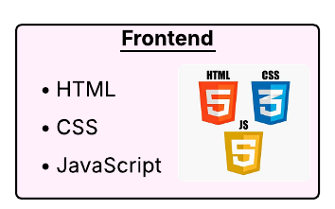


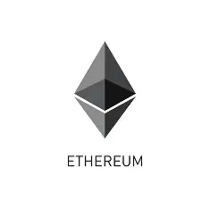

Technology used
MetaMask / Web3 Provider: Connects web app to blockchain
Ethereum Blockchain: Immutable and secure vote storage
Wallet Address Authentication: Verifies voter via wallet ownership
Web3.py: Python interface for blockchain interaction’
Flask API:Backend logic and authentication handler
MTCNN: Accurate real-time face detection
InceptionResnetV1 (VGGFace2):Facial feature extraction and recognition

Slide 8
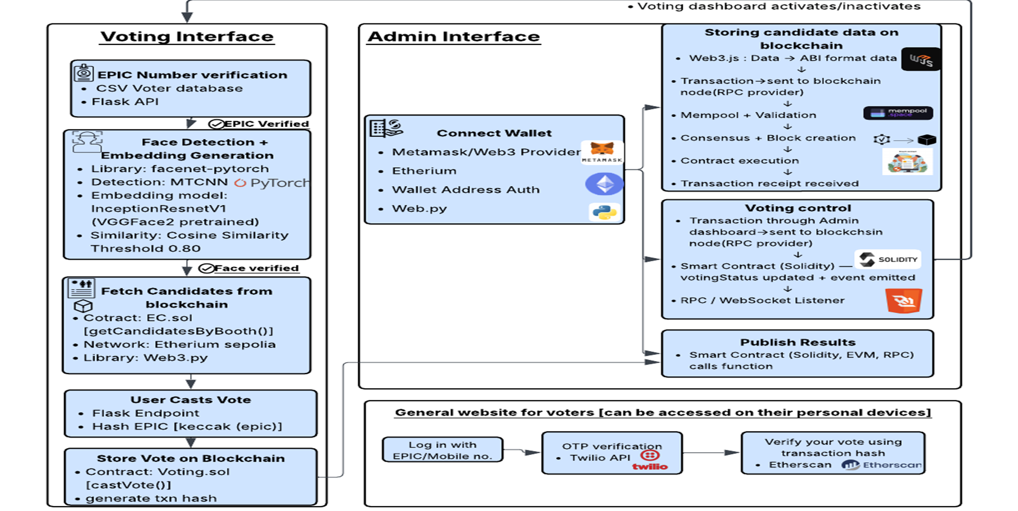
Technical flow diagram -

Slide 9
Architecture Blueprint

Slide 10
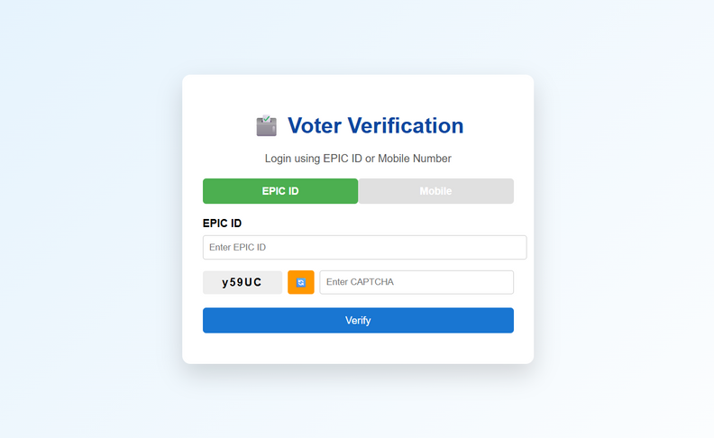
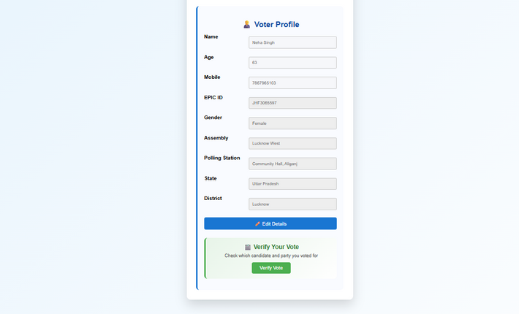
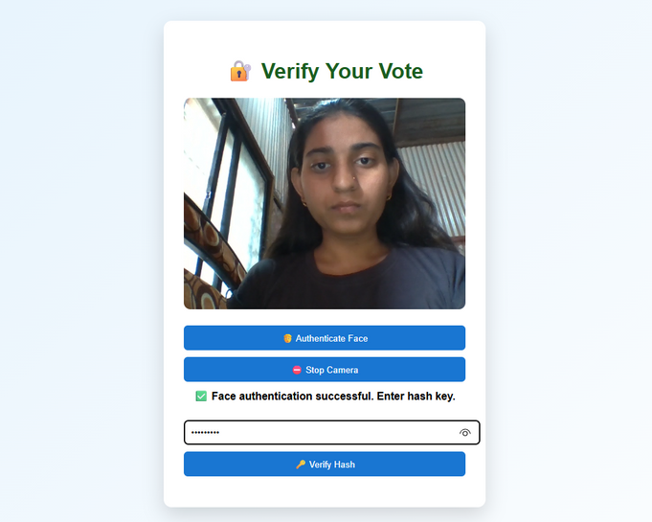
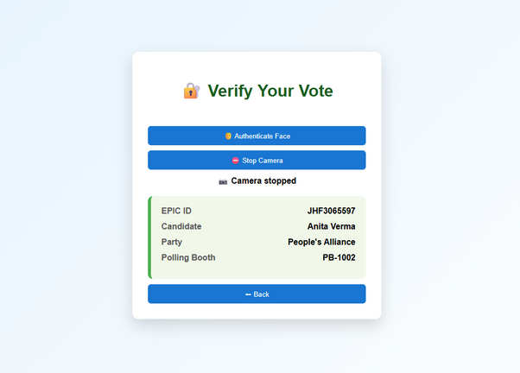
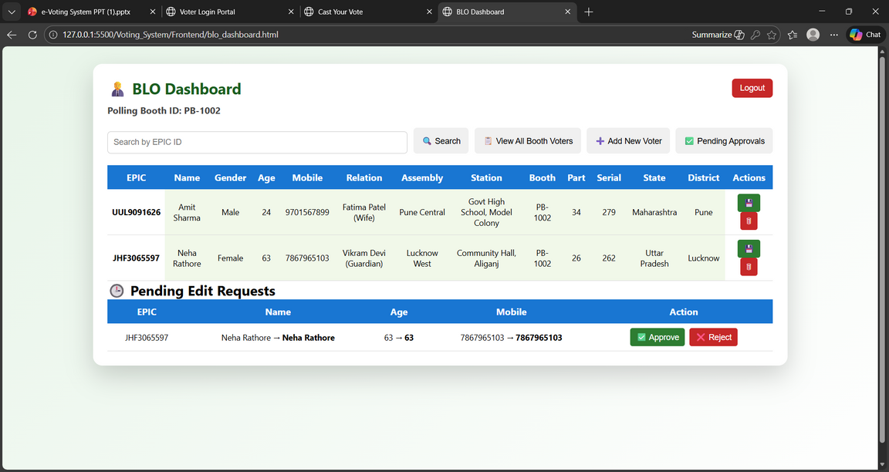
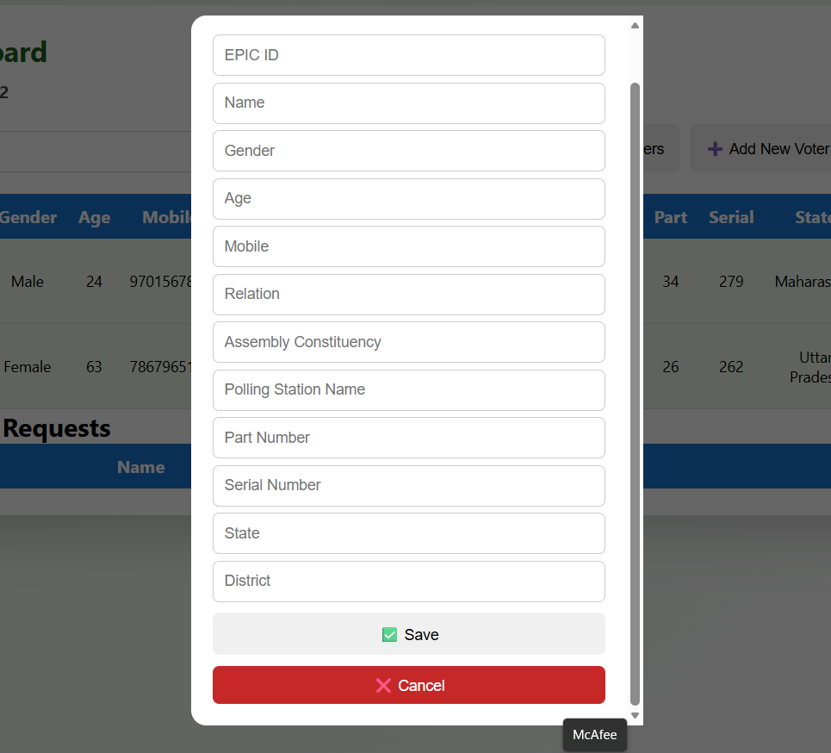
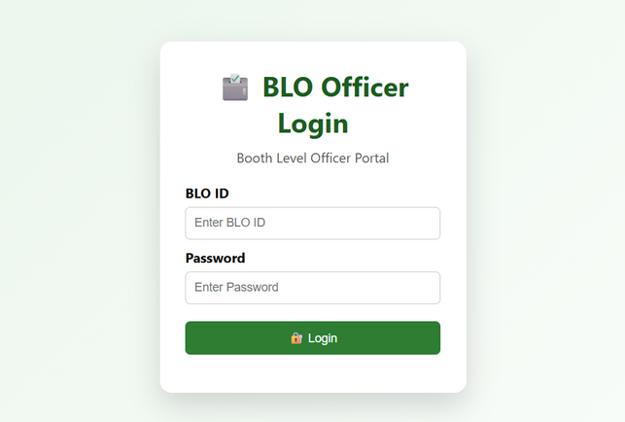
Workflow diagram
Voter's Interface
Voter's login by EPIC ID/Mobile No.
Voter can send request to BLO to update info.
Face Authentication of Voter to verify the vote
After Verifying Hashkey sent to voter they can verify their vote
BLO Interface
BLO's can Edit info of their voters, delete voters and approve requests to update info of voters
BLO's can Add new voters to their respective polling booths
BLO's can login by their ID

Slide 11
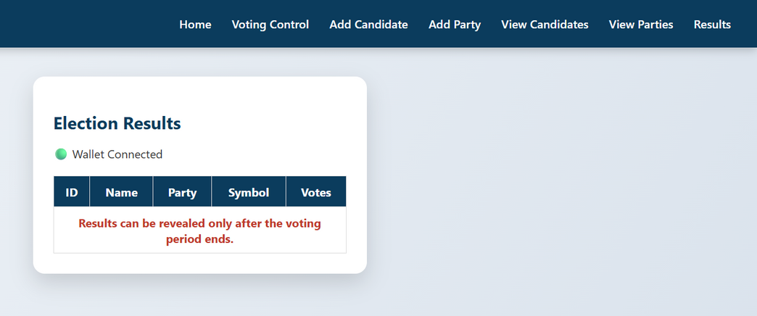
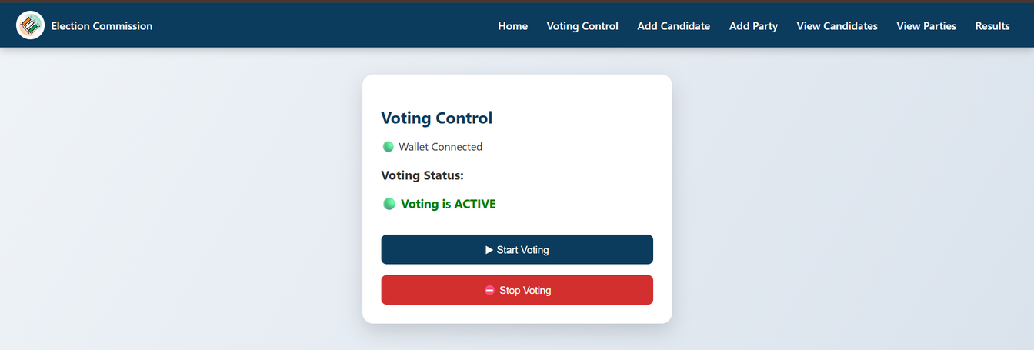
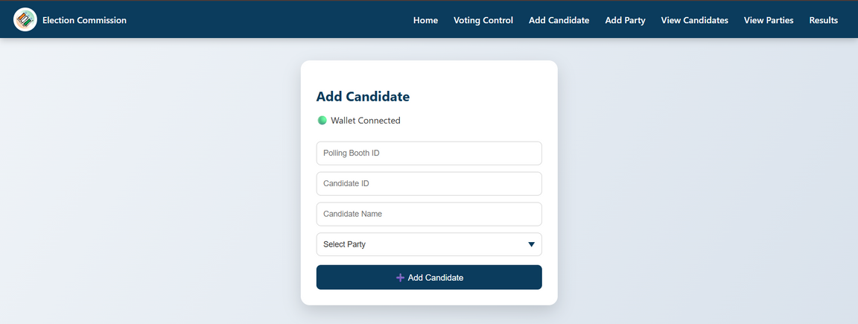
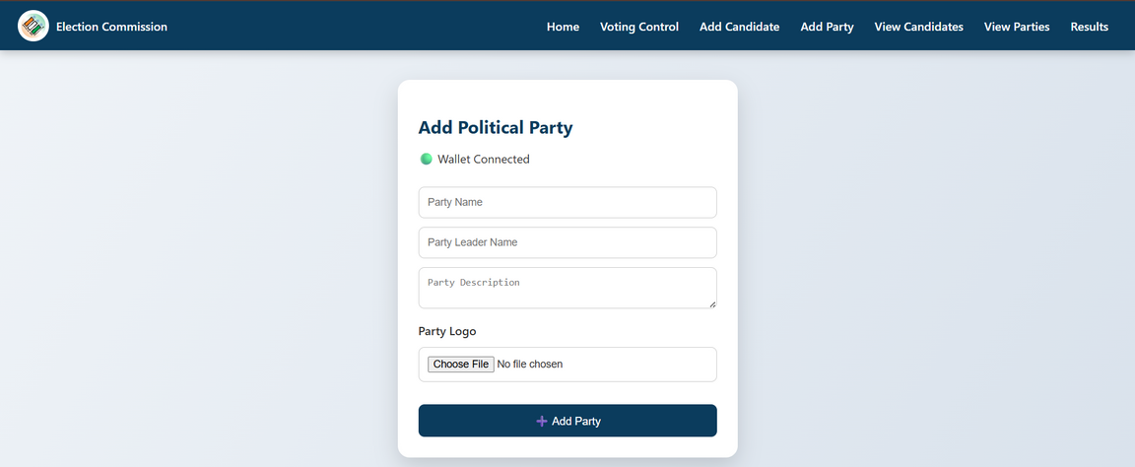
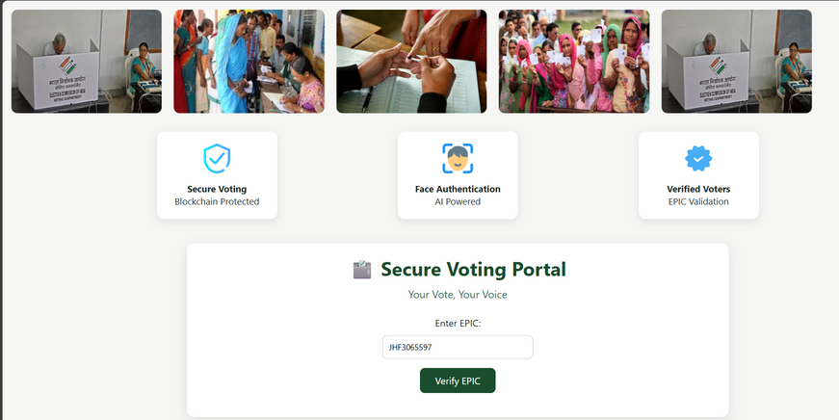
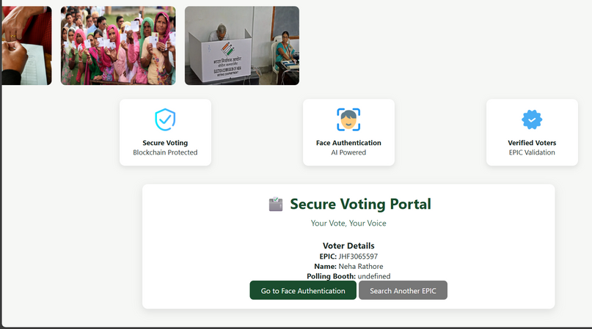
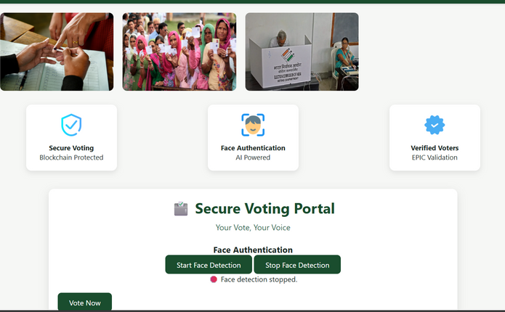
Screen shots of your project -
Admin Dashboard
Election commission can control Voting across polling booths
Election commission can Add candidates
Political Party can be added
Results can be displayed without any manual work
Voting Dashboard
Before Voting, voters are verified by EPIC ID
After EPIC verification Info of voter will displayed
Before voting face verification of voter will be done

Slide 12
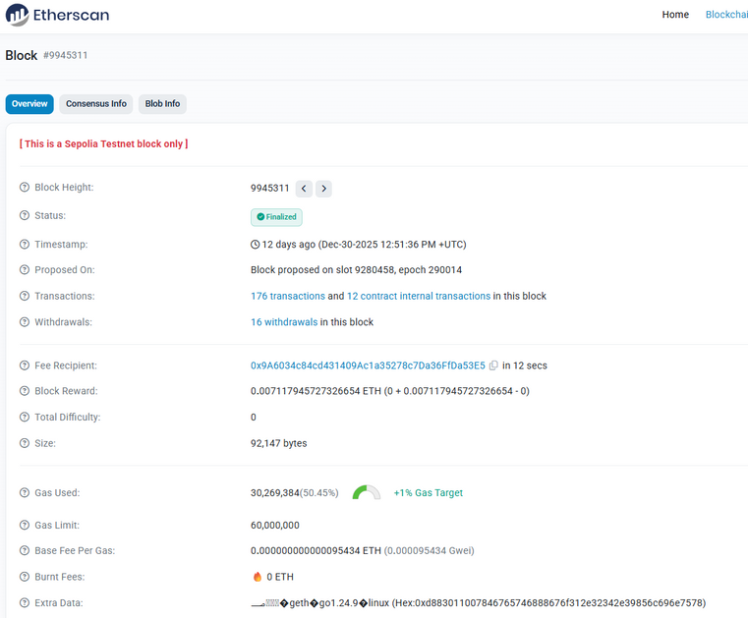
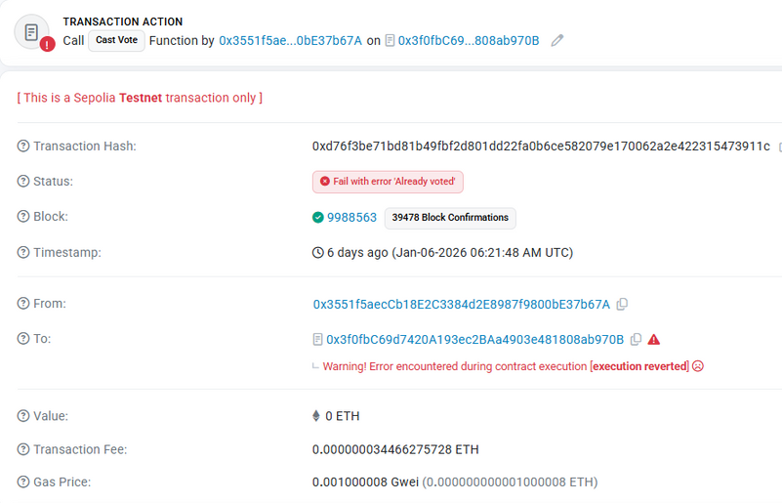
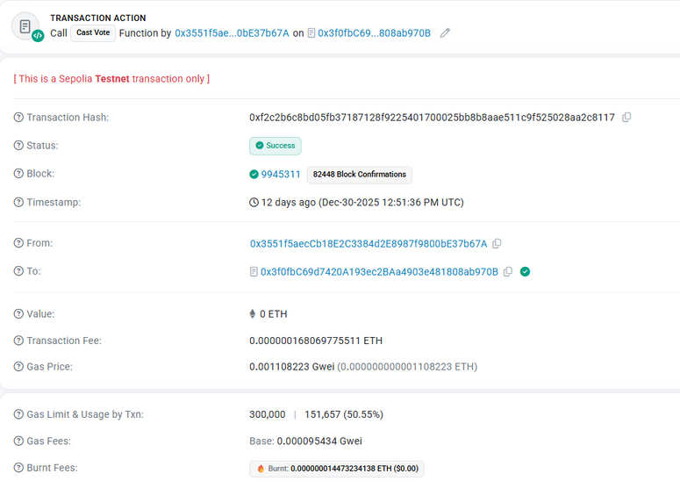
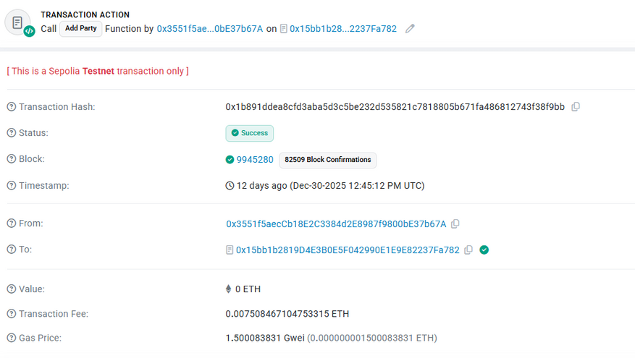
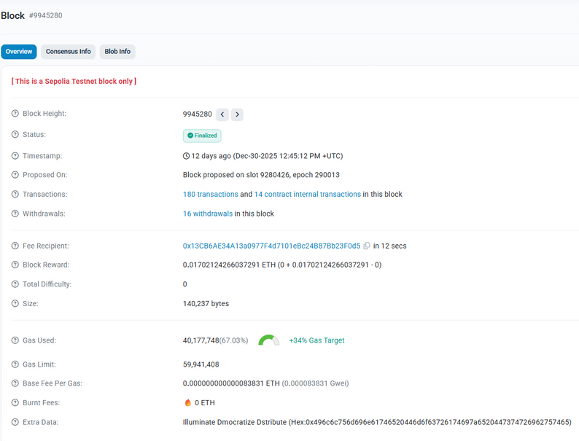
Screen shots of your project -
Transaction details of casting the vote
Block created for vote
If already voted then reattempt to vote fails
Transaction details of adding the party
Block created for party

Slide 13
Role of Blockchain in our Solution
Immutability (Tamper-Proofing): Even an administrator with backend access cannot alter or delete a vote after it has been mined into a block. This solves the "insider threat" problem prevalent in traditional systems.
2. Transparency & Public Auditability: Any authorized entity can verify that the total vote count matches the recorded transactions on the blockchain without needing to trust a central server's claims.
3. Decentralized Trust: By using smart contracts on a network like Sepolia, you ensure that the election rules are executed exactly as written without human intervention.
4. End-to-End Verifiability: The ability for a voter to query the blockchain with their unique hash to see their recorded choice provides a high level of confidence in the system.
5. Smart Contract Automation: Serve as the "Digital Rulebook.“, The only ElectionCommission modifiers can access control and timing programmatically. Thus, it is technically impossible to cast a vote before the EC starts the election.
6. Cryptographic Integrity (Hashing): Ensures voter uniqueness. System has an epicHash (Voter ID hash). This allows the system to check if someone has already voted without necessarily storing their plain-text identity, ensuring privacy and auditability.
7. Distributed Ledger Technology (DLT) plays role in data redundancy and availability. Since the votes are stored on a blockchain, the data is distributed. Even if main server goes down, the election results remain safe and accessible on the blockchain nodes.
8. Role of Web3 Interface : This layer translates user actions into signed transactions on the Ethereum network, ensuring that the frontend remains user-friendly while the backend remains cryptographically secure.

Slide 14
Value Proposition:
Blockchain-based system: Immutable, tamper-proof, traceable.
Strong voter verification: avoids duplicate/fake voting
Auditable: Voter can secretly verify his/her vote casted correctly
Accessible voting: Migrants can vote from nearest polling station; fast and efficient than postal voting
Faster and accurate result declaration
Powerful admin control but with limited manipulation power- efficient, automated yet transparent
Uniqueness
Biometric-Based Vote Locking : Once a vote is cast and voter is verified using face authentication, voter is cryptographically locked, preventing any further voting attempts.
Voter-Verifiable Voting : Voters can personally confirm that their vote was recorded exactly as intended.
Real-Time Vote Tallying : Our System supports real-time vote tallying as votes are recorded on the blockchain.
End-to-End Digitization : Our system eliminates manual and paper-intensive election procedures.

Slide 15
Git Hub Link
Please create public GitHub repository (Enable Add README button while creating repository)
with format:
Please test and Paste the working GitHub URL –
Make sure you have Uploaded following three files into your github repository
1. app.py file ,
2. your_hackthon_problemstatement.pdf file
3. your projectpresntation.pptx file

Slide 16
Future Scope
Stronger Biometric Verification : In the future, the system can include additional biometric methods such as fingerprint or iris recognition to handle cases where face recognition alone may not be sufficient, such as with twins or individuals having very similar facial features, thereby improving overall security.
Region-Based Election Management : The platform can be expanded to fully support election processes at the district and state levels for municipal corporation and panchayat elections. This will ensure that voters participate only in their respective areas and that results are published accurately at each administrative level.
Support for Regional Languages : To make the system more user-friendly, options for regional languages can be added based on the selected state. This will allow voters to comfortably use the system in their native language.
Better Accessibility for Differently-Abled Voters: Future improvements can focus on enhancing accessibility by adding features like voice-guided voting, screen reader support, and simplified interfaces. These changes will help visually impaired and differently-abled voters cast their ballots independently and confidently.

Slide 17

Bank Details
Full Name (as per bank records): | Bank Name | Branch Name | Account Number | Account Type (Savings / Current) | IFSC Code
Tanushri Pritam Khatri | Bank Of Baroda
Priya Bharat Pawar | State Bank of India | DP Road Kothrud | 43903743486 | Savings | SBIN0020734
Insert photo of passbook / bank statement
Insert photo of passbook / bank statement
Insert photo of passbook / bank statement
Team Member 1
Passbook/ Bank Statement With Name and Account Number
Team Member 2
Passbook/ Bank Statement With Name and Account Number
Team Member 3
Passbook/ Bank Statement With Name and Account Number

Slide 18
Thank You

